Slide 1
CS4101 Introduction to Embedded Systems Lab 5: Low-Power Optimization
Prof. Chung-Ta King
Department of Computer Science
National Tsing Hua University, Taiwan

Slide 2
Lab 5
Basic 1: Based on Basic 1 of Lab 4 (60%)
Normal state: runs flash pattern 1 while keeps measuring temperature, enters the CPU into LPM3
Flash pattern 1: turn red LED on for 0.6 sec first and then green LED on for 0.4 sec alternatively by Timer1_A3 driven by ACLK sourced from VLO running at 12KHz.
Temperature measurement: measure temperature every 1.2 sec using single-channel-single-conversion but triggered continuously by Timer0_A3 driven by ACLK sourced from VLO and by 1.5V voltage reference.
If the temperature is above 28。C, then enter into the emergency state.
Count the amount of time CPU is in LPM3. Use debugger to show the accumulated count and the temperature.

Slide 3
Lab 5
Basic 1: (cont.)
Emergency state: runs flash pattern 2 while keeps measuring temperature, enters the CPU into LPM0
Flash pattern 2: turn both LEDs on for 0.3 sec first and off for 0.2 sec alternatively by Timer1_A3 driven by ACLK sourced from VLO running at 12KHz.
Temperature measurement: measure temperature every 0.4 sec using single-channel-single-conversion but triggered continuously by Timer0_A3 driven by ACLK sourced from VLO and by 1.5V voltage reference.
If the temperature is below 28。C, then enter into the normal state.
Count the amount of time CPU is in LPM0. Use debugger to show the accumulated count and the temperature.

Slide 4
Lab 5
Basic 1: (cont.)
Requirement: only use the following ISRs
#pragma vector = TIMER0_A0_VECTOR
__interrupt void TA0_ISR(void){}
#pragma vector = TIMER1_A0_VECTOR
__interrupt void TA1_ISR(void){}
#pragma vector = ADC10_VECTOR
__interrupt void ADC10_ISR(void) {}

Slide 5
Lab 5
Basic 2: (40%)
Same as in Basic 1, except how temperature is measured in the emergency state
Emergency state:
Temperature measurement: measure temperature every 0.4 sec using DTC (repeat-single-channel) triggered by Timer0_A3 driven by ACLK sourced from VLO and by 1.5V voltage reference.
Each time DTC is called, take 6 measurements and calculate the average temperature. If the average falls below 28。C, then return to normal state.
Count the amount of time CPU is in LPM0. Use debugger to show the accumulated count and the temperature.

Slide 6
Lab 5
Basic 2: (cont.)
Compare the time in LPM0 with the results from Basic 1.
Requirement: only use the following ISRs
#pragma vector = TIMER1_A0_VECTOR
__interrupt void TA1_ISR(void){}
#pragma vector = ADC10_VECTOR
__interrupt void ADC10_ISR(void) {}

Slide 7
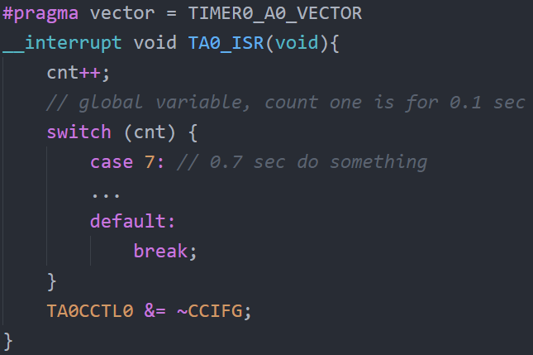
Requirements
Handle all the events by interrupts, so no code is in the loop of main() and no busy waiting.
No counter for calculating the time.

Slide 8
Hint
Voltage = T * 1.5 / 1023 , where T is the value of ADC10MEM
Celsius = (Voltage - 0.986) / 0.00355

Slide 9
Grading Policies
DEMO in the lab --------------------------------------100%
DEMO within a week ----------------------------------80%
DEMO after a week ------------------------------------60%
After two weeks ----------------------------------------- 0%

